Slide 1





Customer Success Team
Team Data Analyst

Slide 2

Content of the slides
Description of the dataset
Groups which solves the query quickly
Efficiency on the basis of the group
Quickest and Slowest Group on the basis on Resolution time.
Efficiency on the basis of communication
Resolution speed on the basis of priority level.
Category Whose tickets are solved quickly
Rate of satisfaction among the Groups
Problem and solution statement.

Slide 3
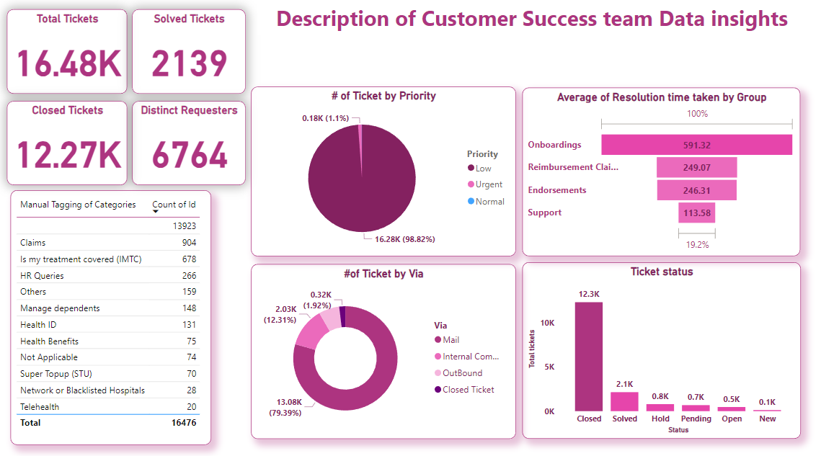
Untagged category has most number of ticket followed by Claims
Low priority tickets are highest in number
Mail is mostly used as source of communication
Closed ticket status is highest
Onboarding takes most of the time

Slide 4
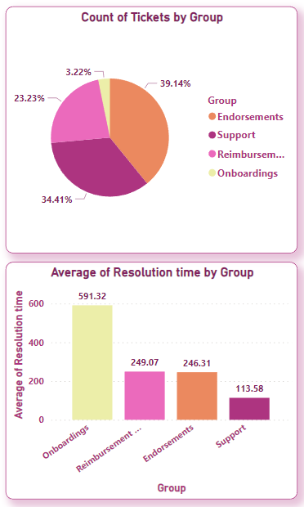
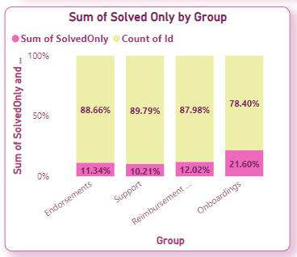
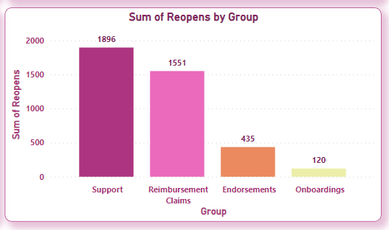
Group which solves the Query quickly
Quickest Group:
Endorsement group has highest number of query.
Endorsements group solves the query quickly.
Improvement Needed:
The point to be noted is that support takes lesser time to resolve the query but reopening of the tickets is highest in Support so
Tip is that support should work upon resolving the tickets in better way to reduce the reopening.

Slide 5
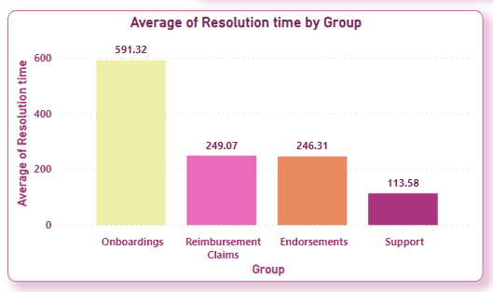
Efficiency Number of the basis of Groups
on bases of resolution time
Support Group is most efficient in resolving the ticket.
Endorsements group is efficient in resolving the ticket
Reimbursement Claims on moderate level in resolving ticking
Onboarding has lowest effective

Slide 6
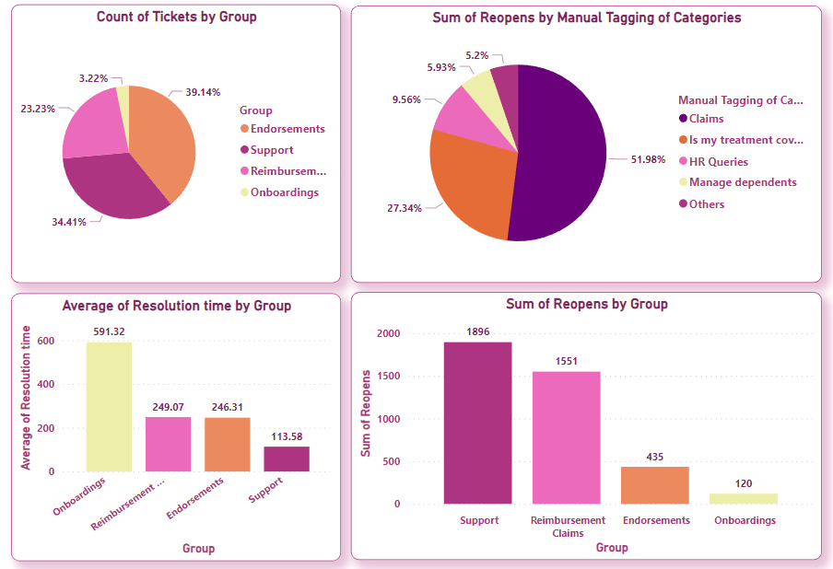

Quickest and Slowest Group on the basis on Resolution time.
Key Insights:-
Endorsements group has highest number of tickets, followed by support group.
Onboardings has lowest number of tickets
Average Resolution time by Group
Onboardings is the slowest group of all in solving the tickets.
Reimbursement Claims is second slowest.
Support is the fastest group.
Sum of Reopens ticket by Group:-
Support has maximum no of reopening ticket.
Reimbursement claims tickets open second highest in the group.
Onboarding opens in least amount.
Conclusion: Support is the quickest group of all but does not able to resolve tickets completely as most of the reopening ticket is high in support group.
Claims has highest no. of reopening tickets by category so should work on claims category to solve ticket in lesser time.

Slide 7
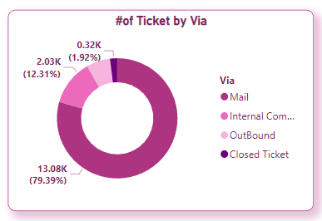
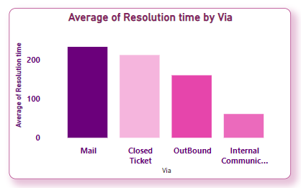
Efficiency Number on basis of Via
Efficiency Number on bases of Resolution time taken via
Internal Communication has second highest ticket received but Most efficient in resolution time.
Onboarding takes second least time so its
Second most effective
Closed ticket is moderate efficient
Mails has high level of ticket received but resolution time by mail is low in efficiency

Slide 8
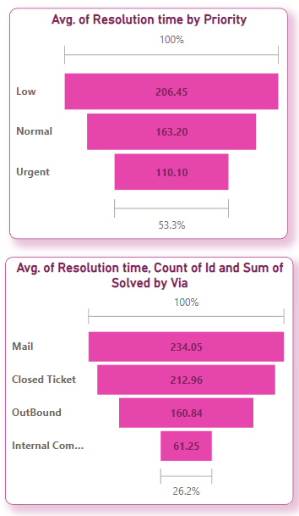
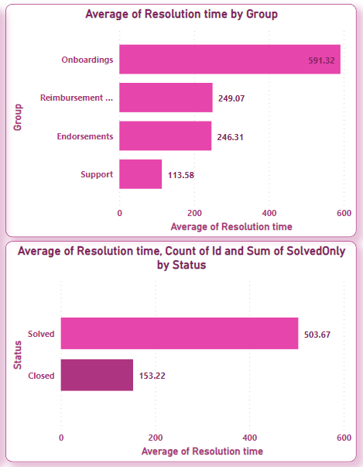

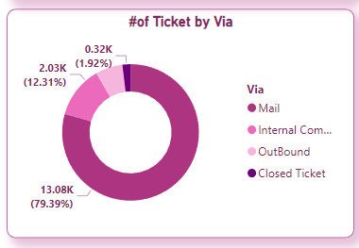
Resolution Speed on the basis on Priority Level
Conclusion
Resolution time taken by urgent priority is less which is a good point.
Via Mail is very slow in solving the tickets
when compared to other methods.
Although the tickets are received mostly form
Mail but the internal communication tickets are closed most quickly.
So team should work on resolving the ticket.

Slide 9
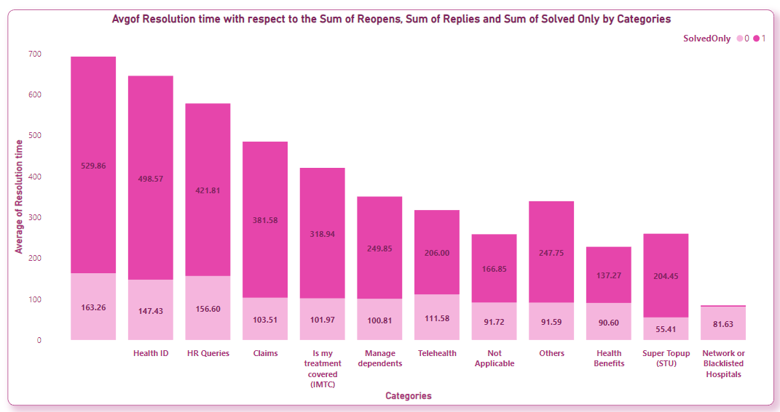
Categories whose tickets are Solved Quickly
Conclusion :
Least time taken to solve the ticket is by the category Network or Blacklisted Hospitals.
Heath Benefits is second in solving the tickets quickly.
The non- tagged category is the slowest among all the categories
The Health ID and HR Queries are the next slowest in the categories
Tips
The non tagged, Health ID, HR Queries and Claims category should work on solving the queries quickly.

Slide 10
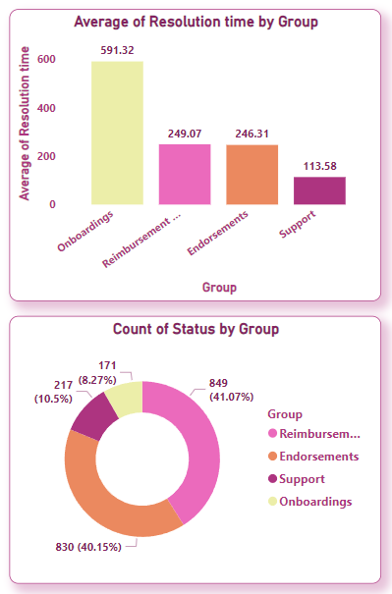
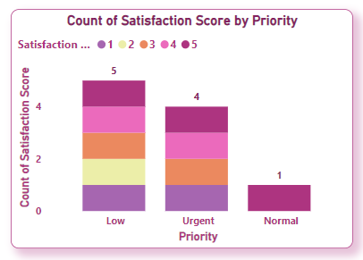
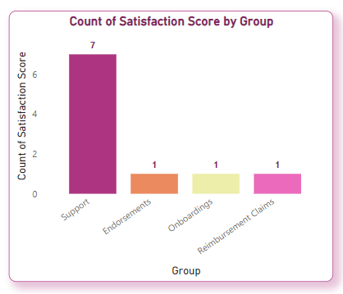
Rate of satisfaction among the Groups
Conclusion
Support has highest count of satisfaction rate.
Endorsement has second highest satisfaction rate.
Satisfaction Score of Low priority is highest.

Slide 11
Problem Statements
Suggestion for solution
Support Solved Tickets
Support tickets are solved most quickly
Reopening In Support Group
Support has highest number of reopening among the group
Support group should on the quality of the ticket and solve resolve the ticket with efficiency.
Most of the tickets are registered through mail but action is not taken quickly via mail.
Mails method should work more efficiently to solve the tickets quicker
The non- tagged category is the slowest among all the categories
The Health ID and HR Queries are the next slowest in the categories
The non- tagged, Health ID and HR Queries should work quickly on the tickets among the categories.

Slide 12
Different Data Type
Primary Key- Qualitative datatype- 'Id’
Numerical Type: 'Requester id’, 'Reopens', 'Replies', 'First reply time in minutes within business hours', 'First resolution time in minutes', 'First resolution time in minutes within business hours', 'Full resolution time in minutes', 'Full resolution time in minutes within business hours', 'Requester wait time in minutes', 'Requester wait time in minutes within business hours’.
Temporal Type : Datetime - 'Created at', 'Initially assigned at', 'Assigned at', 'Solved at', 'Updated at’
Categorical Type : Datetime - 'Group', 'Status', 'Priority', 'Via', 'Resolution time', 'Satisfaction Score', 'Manual Tagging of Categories'

